Slide 1
Behavioral results

Slide 2
Training:
Z = 4.2
R L R L
X = -16
Y = 6
Z = -6
Z = 2.3
All Go / last scan / modulation by probe effect 22 / 8 / 2

Slide 4
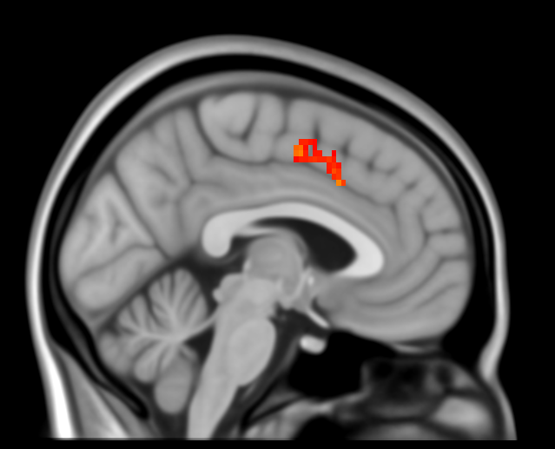
Training:
X = - 3
Z = 4.2
Z = 2.3
All Go > NoGo / last scan > first / modulation by probe effect 23 / 9 / 2

Slide 5
Probe:
Z = 4.2
R L R L
X = 4
Y = 50
Z = -18
Z = 2.3
All Go > NoGo / mean / modulation by probe effect 21 / 1 / 2

Slide 6
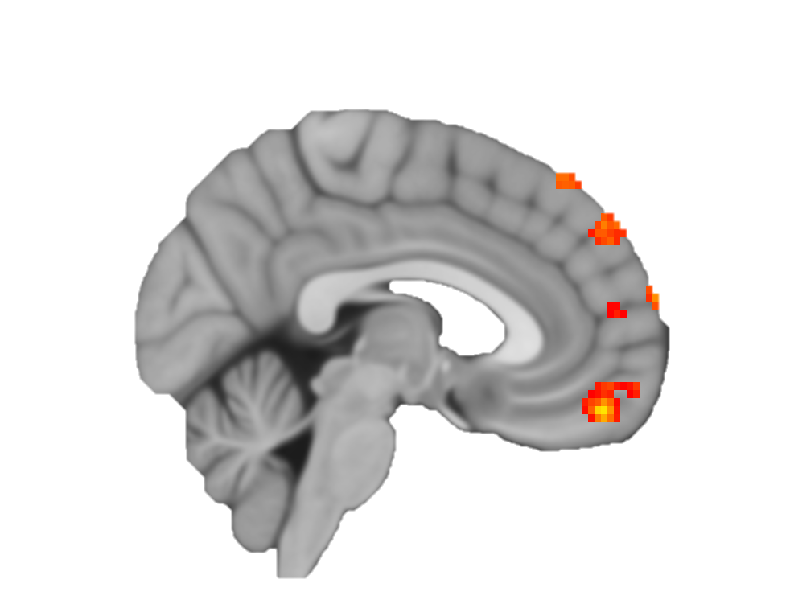
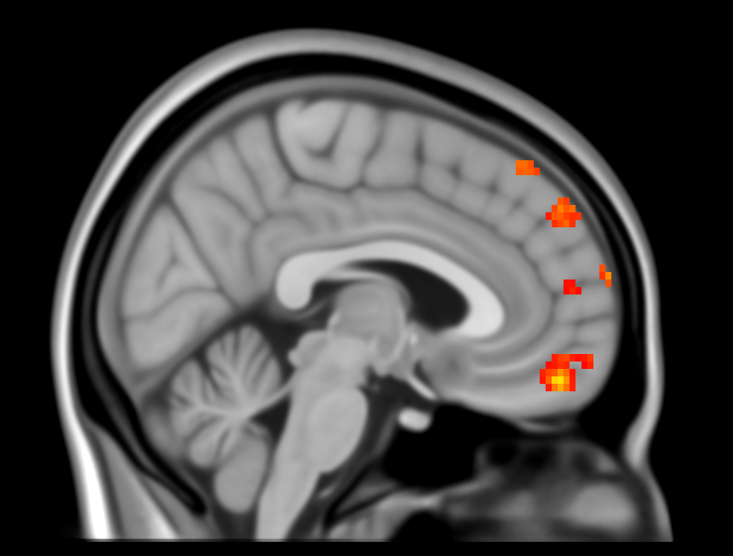
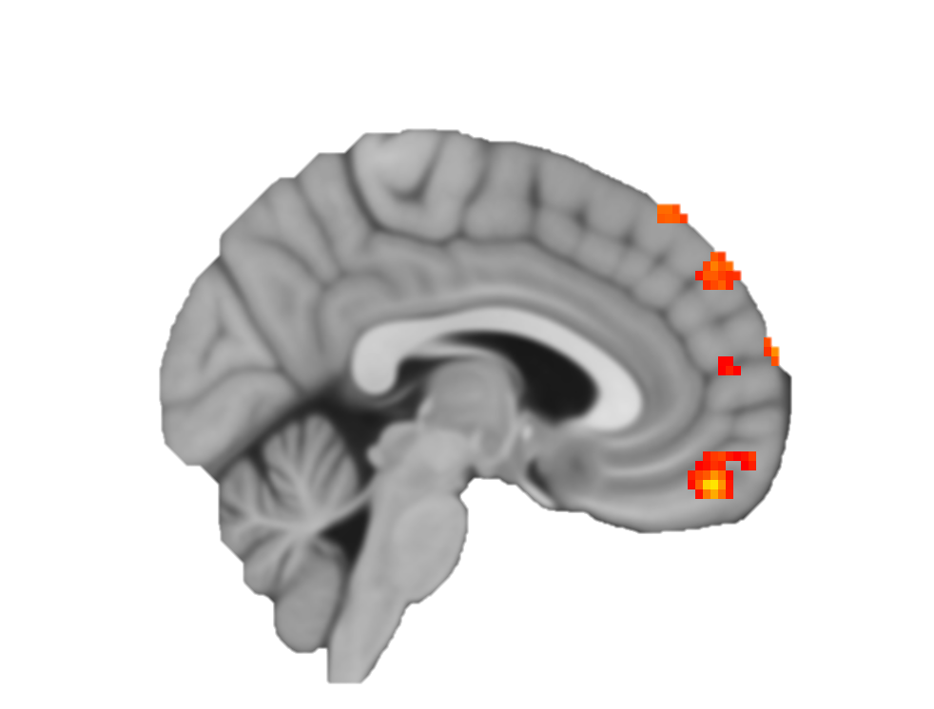

Slide 7
Probe – follow-up:
Z = 4.2
R L R L
X = -40
Y = -40
Z = 44
Z = 2.3
All Go > NoGo / mean / modulation by probe effect 21 / 1 / 2

Slide 8
Probe – follow-up:
Z = 4.2
R L R L
X = 21
Y = -17
Z = -21
Z = 2.3
LV Go > NoGo / mean / modulation by probe effect 19 / 1 / 2

Slide 9
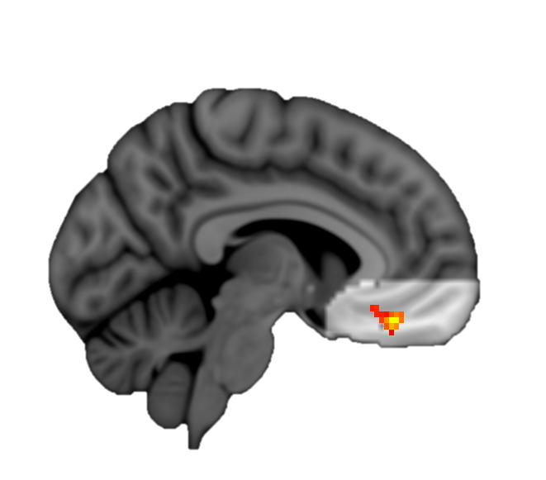

Slide 10
Response to stim – follow-up:
Z = 4.2
R L R L
X = -48
Y = -76
Z = -16
Z = 2.3
All Go / after > before / group mean 23 / 1 / 1

Slide 11
Response to stim:
Z = 4.2
R L R L
X = -15
Y = -4
Z = 21
Z = 2.3
All Go > NoGo / after > before / group mean 17 / 1 / 1

Slide 12
localizer:
Z = 6.0
R L R L
X = 46
Y = -46
Z = 17
Z = 3.1
Sub 008

Slide 13
localizer:
Z = 6.0
R L
X = 46
Y = -46
Z = 17
Z = 3.1
Sub 009

Slide 14
Training accuracy: 74%, CV accuracy: 50%, p = 0.47
False Negative
True Positive
Prop. Go items were chosen
True Negative
False Positive
SVM Hyperplane Distance

